Slide 1
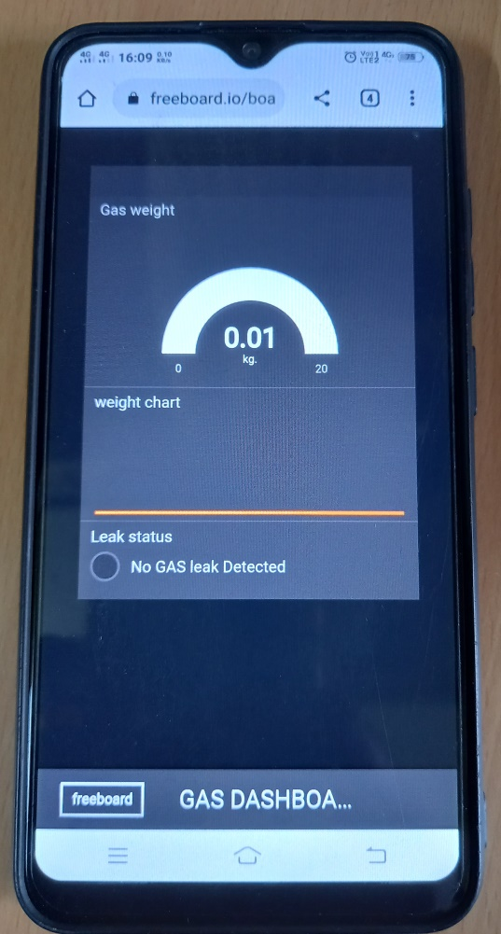
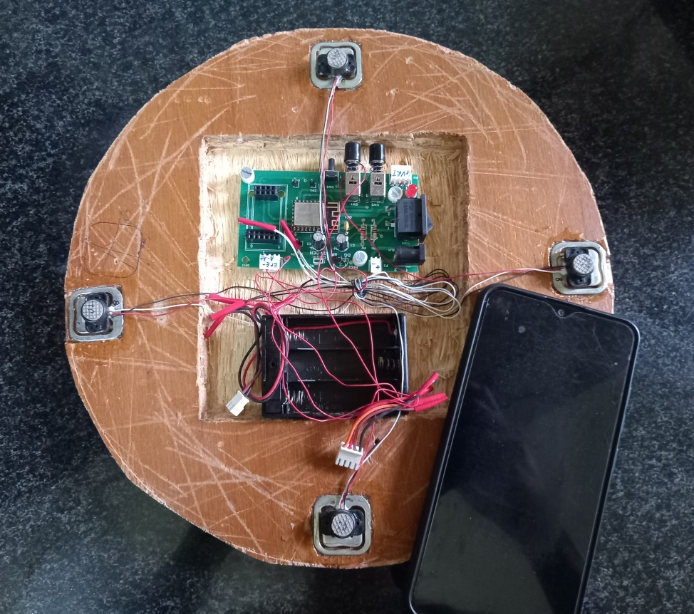
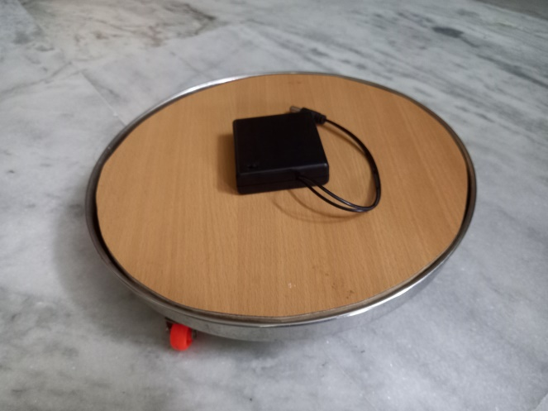
Smart Gas Trolley
Track cylinder weight | Sense gas leakage

Slide 2


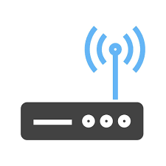

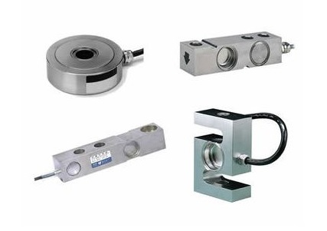

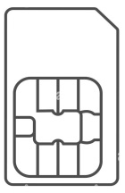




Cloud Architecture
Dashboard
Router
HX-711
(optional)
IoT device
(ESP8266)
Load cells
Buzzer

